Slide 1
Functions
Introduction to Python for Security

Slide 2
Course Path
Introduction to Python for Security
Introduction to Programming
Data Types & Conditions
Loops
File System & Error Handling
Python for Security
Network Communication
Functions

Slide 3
Objectives
Functions
This lesson is an introduction to Python functions and code handling. The concepts of recursion and object-oriented programming are also introduced and demonstrated.
Introduction to Functions
Code Handling
Recursion
Object-Oriented Programming

Slide 4
Introduction to Functions
Functions

Slide 5
Why Functions Are Needed
Introduction to Functions
from random import randrange dice = {1:0, 2:0, 3:0, 4:0, 5:0, 6:0} dice_roll = int(input("Times to roll the dice: ")) print("Rolling the dice") for i in range(dice_roll): dice_roll_res = randrange(1,7) dice[dice_roll_res] += 1 print(dice)
Functions are necessary to prevent code from becoming difficult to understand.
They save the time and effort of having to write the same functional code in different parts of a program.
They also make code maintenance more efficient.
Notes:
Explain that, for code to be efficient and easily understandable, it must include functions.

Slide 6
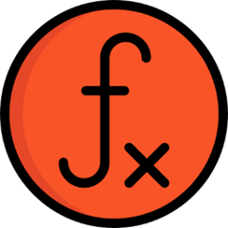
What Are Functions?
Introduction to Functions
Blocks of code with reusable logic
Define functionality in the program.
Separate programs into small, readable, and manageable sections.
Functions are not parts of other elements in a script.
Methods are functions that are parts of other elements in a script.
Notes:
Emphasize the importance of functions, how they help programmers avoid reusing code, and how they help make overall code management more efficient.
Point out that functions can be shared among programmers and programs, simplifying code management.

Slide 7
Function Declaration
Introduction to Functions
def Print_Multiple(message, times): for i in range(times): print(message) Print_Multiple("Hello", 2) Print_Multiple("Hi!")
A function must be defined first with the def keyword.
After def, the name of the function is provided.
The last part is parentheses () for optional parameters and a colon : to define the code block.
Notes:
Create a function, explain the importance of indentation, and explain the def keyword.
Encourage learners to create a simple function like the one in the example.
On the next slide, we will name it and invoke it.
Create a function that receives two variables and prints them.
Invoke the function with and without the variables, to show its execution and the error it can generate.
The example above shows how functions get parameters and print the values. It also shows
what happens when we call a function without the number of parameters it was defined to receive.
Practice:
Ask learners to write a function that gets two integers and prints their sum.

Slide 8
Invoking a Function
Introduction to Functions
def greetings():
name = input(“Enter your name: ”)
print(“Greetings, {}!”.format(name))
greetings()
A defined function will not yet be executed by Python.
It must first be invoked before it can be used.
Functions can also accept parameters.
Notes:
Invoke the function for the class and show that the action included in the function is executed.
Explain the structure of the function and the code block associated with it.
Discuss the syntax used to call a function.
Example:
Write a function that prints the time whenever you call it (use the datetime library.)

Slide 9
Default Values
Introduction to Functions
def print_my_mood(mood="happy"): print(mood) print_my_mood() print_my_mood("sad")
==========================================================
"C:\Users\johnd\PycharmProjects\Python\venv\Scripts\python.exe" "C:/Users/johnd/PycharmProjects/Python/PY-05/Default Values.py"
happy
sad
Process finished with exit code 0
Function parameters can include default values.
If no value is passed, the default value will be used.
If a value is passed, the default value will be overridden.
Notes:
Discuss default values passed to functions and demonstrate how a function with a default value is applied and overridden.
In the explanation above, the function is called with and without a value.
Example:
Create a function that gets full_name, and prints: “Hi [full name]. Welcome to our site.”
If no value was sent to the function, print: “Name is required… Logging off.”

Slide 10
Returning Values
Introduction to Functions
def Calculation(x, y):
answer = x + y
return answer
Result = Calculation(2, 4)
Functions can pass data at the end of the execution.
The return keyword is used to pass the values.
return also terminates the execution of a function.
Notes:
The example shows a function that calculates the sum of two variables.
Discuss the meaning of the return keyword and return the result.
Explain that the return command must be the last to execute in the logic flow.
Practice:
Write a function that gets two strings (name, email).
The function will use string concatenation and return a string var, as follows:
“Welcome [name]. Your email address is [email].“
Then print the string outside the function’s scope.

Slide 11
Lab PY-05-L1
Introduction to Functions
Create a function to handle calculation operations.
Calculator
15–25 Min.
Declare input variables.
Define basic calculation functions.
Define the main function.
Write the function invocation logic.
Windows/Linux
Python 3
PyCharm
Lab document

Slide 12
Returning Data
Introduction to Functions
def return_multiple(): first_name = "John" last_name = "Doe" return first_name, last_name print(return_multiple())
=========================================================================
('John', 'Doe')
Process finished with exit code 0
A function can return multiple values, a list, or a dictionary.
Each type of returned information is placed in separate parentheses.
Commas are used to separate the values.
Notes:
Talk about the need to return multiple values, and how that is done using commas to separate them.
The code in the example will print both the first name and last name returned from the function.
Note that it will return as a tuple.
Mention the option of returning a list of items from a function.
Practice:
Create a function that gets a number and creates a list from 0 to the number.
Save it in a variable and return the variable.
Print the list in the main scope.
Talk about what a dictionary is and let learners create a dictionary.
Return the entire dictionary from a function and print it to show how the dictionary is returned.
We can create the dictionary in the function and return it using curly brackets or as a variable.
Practice:
Create a function that creates a dictionary of three names and ages.
Return the dictionary and print it in the main scope.

Slide 13
Complete Function Example
Introduction to Functions
from random import randrange def main(): dice = {1:0, 2:0, 3:0, 4:0, 5:0, 6:0} dice_roll_res(dice) def dice_rolling(): rolls = int(input("Times to roll the dice: ")) print("Rolling the dice") return rolls def dice_roll_res(dice): for i in range(dice_rolling()): roll_res = randrange(1,7) dice[roll_res] += 1 print(dice) main()
def defines a function.
The function name with parentheses will set the parameters.
return ends the execution and returns the result.
Notes:
The function shown in the example receives two numbers, adds them together, returns the result, and prints it.
Let learners create the function on their own.
Practice:
Write a function that gets a number that represents the number of learners.
The function uses the number to ask for each learner’s name in a loop.
The function creates a list, and then returns the string ‘Done’.

Slide 14
None
Introduction to Functions
def first_function(): return def second_function(): return None def third_function(): x = 5 print(first_function()) print(second_function()) print(third_function())
=========================================================================
None
None
None
Process finished with exit code 0
None is not a value and refers to empty data.
It cannot be used in expressions but can be inserted in a variable or compared with them.
Every function by default returns a None value.
Notes:
The example shows a case in which a function returns None.
In the example, the function does not include the return keyword.
Explain that None is a data type that does not represent 0, false, or an empty string.
It is a reserved word in Python that refers to an empty value.
Let the class experiment with attribute manipulation in their functions.
Practice:
1. Work with the script in the slide.
2. Create a variable for a function that does not return a value.
3. Print the variable in the main scope and check the output.

Slide 15
Lab PY-05-L2
Introduction to Functions
Create multiple functions that return different list types and check their types.
Returning Lists
15–25 Min.
Define functions.
Return different data structures.
Print outputs.
Windows/Linux
Python 3
PyCharm
Lab document

Slide 16
Code Handling
Functions

Slide 17
Scope
Code Handling
def func(): txt = "hi" print(txt) func() print(txt)
=================================================================
hi
Traceback (most recent call last):
File "C:/Users/asafr/PycharmProjects/Michigan Python/PY-05/Scope.py", line 6, in <module>
print(txt)
NameError: name 'txt' is not defined
Process finished with exit code 1
Scope is what defines the visibility of a variable.
A variable in a function is accessible only in that function.
There are four types of scope: local, enclosed, global, and built-in.
Notes:
The area of the program to which a particular variable applies is called a scope.
Emphasize the difference between local and global scopes.
Note that in the example, the txt variable is not recognized in the global scope.
Note: It is important to explain the hierarchy from global scope down to local scope.

Slide 18
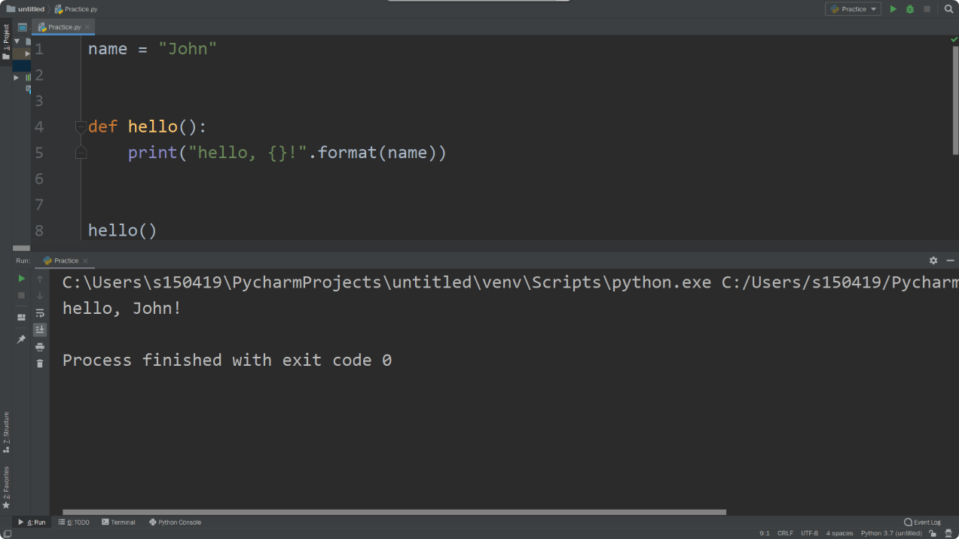
Global Scope
Code Handling
Global scope is the main scope of a program.
Variables defined in a global scope will be recognized in all other scopes as well.
Notes:
Talk about the importance of a global scope.
Different functions can work with the same variable if it is defined in the global scope.
Note: A global variable can be viewed and used in a local scope, but cannot be changed.
Practice:
Create two variables with a company name and ID.
Call a function that makes a dictionary from the two variables and returns it.
Print the dictionary in the main scope.

Slide 19
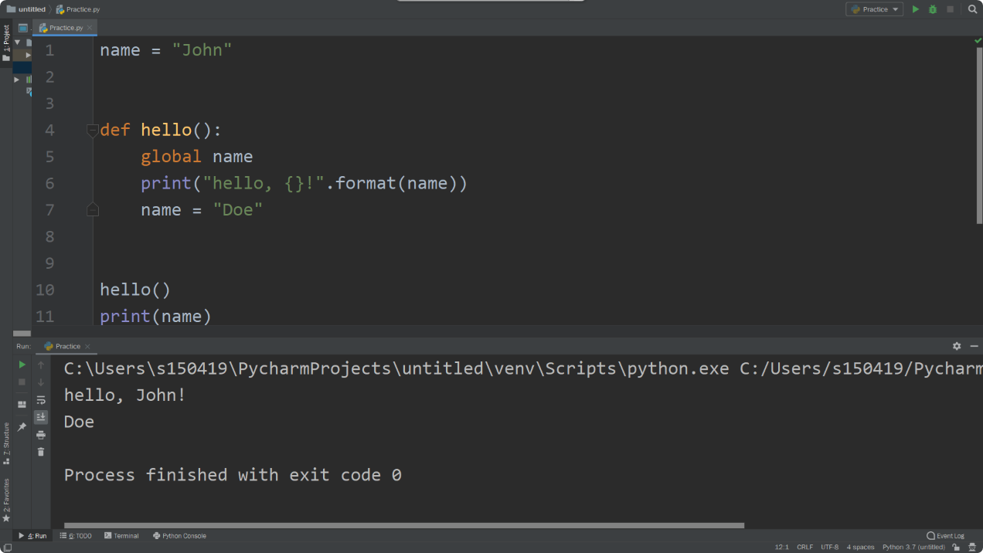
Global Keyword
Code Handling
The global keyword is used to modify a global variable within a function in which a variable of the same name exist.
It instructs Python to use the variable from the global scope.
Notes:
Specify the need for a global keyword, which allows a function to modify global variables.
Without a global keyword, functions can only identify global variables, but not modify them.
Note: Once a global variable is used in a local scope, functions can use the variable and modify it, which means global keywords can be exploited.
Practice:
Create two inputs: name and last name.
Create a function that gets two variables and changes the name var and last var to first letters only.
For example, John will be modified to J.
Then print the variables in the global scope and note the change.

Slide 20
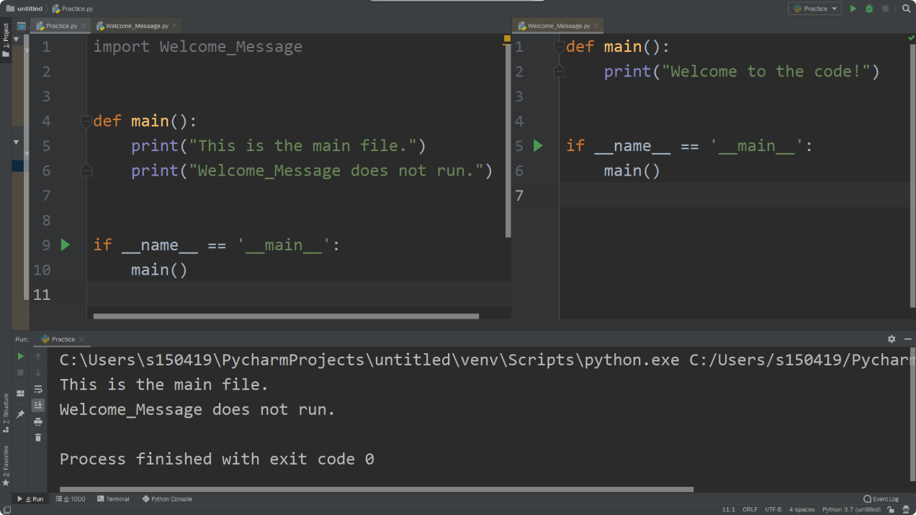
__name__ Variable
Code Handling
Every Python file has the __name__ variable.
It returns a different result depending on the execution state of a file.
The variable can be used to check if a file was imported.
Notes:
Various modules have main functions that run when the code is executed.
When we import external code, we would not want a main function to be executed.
We therefore define a magic main in the code so that only it will be executed, and not any other main function from an external source.
Practice:
Create two Python files, main and util.
Define in both a main() function, whereby each function prints the name of the file they execute from.
Define a magic main in the main file and in the util file.
Examine the results.

Slide 21
Proper Code Management
Code Handling
import random number = random.randint(0, 5) def main(): for i in range(number): print("Hello") if __name__ == '__main__': main()
=========================================================================
Hello
Hello
Hello
Process finished with exit code 0
import should be at the beginning of a program.
Global variables should follow imports.
__name__ == ‘__main__’ should be written at the end of the file.
Notes:
Emphasize how proper code management enables easier reading of the code, and helps other programmers understand its meaning and structure.
Note: It’s important to explain that proper code management is not a rule for coding. The code will run properly even if a programmer does not follow the example shown on the slide. Instead, it refers to a structure that makes the code easier to understand.

Slide 22
Lab PY-05-L3
Code Handling
Create global variables and try to make changes to them within a function.
Scope Behavior
10–20 Min.
Declare global variables.
Create a function to manipulate the variables.
Examine the results.
Windows/Linux
Python 3
PyCharm
Lab document

Slide 23
Lab PY-05-L4
Code Handling
Prepare a program that executes only if its main file is run directly.
Main Identification
15–25 Min.
Create a file to be imported.
Create a function with a print message.
Create a file import operation.
Windows/Linux
Python 3
PyCharm
Lab document

Slide 24
Lab PY-05-L5
Code Handling
Create a game in which a user guesses a random number and receives the correct answer in return.
Bullseye
15–25 Min.
Generate a random number.
Check if the user guessed the correct random number.
Windows, Linux, or macOS
Python 3
PyCharm
Lab document

Slide 25
TDX Arena Challenge
Code Handling
Find the troll’s login information to set the divine memes free!
Troll
Log into TDX Arena and search for the challenge named Troll.
Reverse the legacy troll code.
Find the username.
Find the passwords.
Notes:
TDX Arena challenges can be done at home for extra practice.
Make sure learners remember how to log in.
Mention that the TDX Arena guide is provided in the course's LMS shell.

Slide 26
TDX Arena Challenge
Code Handling
Try to decrypt a message using the Python script you will find.
Blocks
Log into TDX Arena and search for the challenge named Blocks.
Find the Python script.
Try to understand the code.
Decrypt the message.
Notes:
TDX Arena challenges can be done at home for extra practice.
Make sure learners remember how to log in.
Mention that the TDX Arena guide is provided in the course's LMS shell.

Slide 27
Recursion
Functions

Slide 28
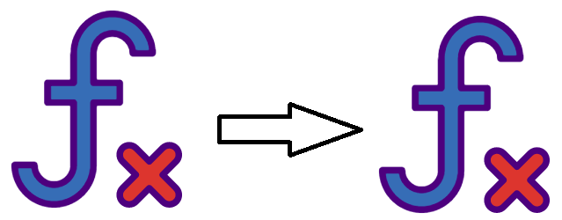
What Is Recursion?
Recursion
Functions that call themselves
Provide a way of looping through data.
Must be handled carefully to prevent endless execution
Notes:
Give a few examples that demonstrate the need for recursion, such as presenting all the numbers in a list, extracting all text files from a folder that contains subdirectories, or opening a box of candies that contain other boxes within it.

Slide 29
Recursion Implementation
Recursion
count = 0 def recur(count): if count == 10: return print("*" * count) count += 1 recur(count) recur(count)
Recursion is implemented by having a function call itself repeatedly.
It should be handled carefully to prevent endless loops.
Notes:
Let learners create a recursion like the one in the example as a follow-up to your explanation and demonstration.
In the example, the function prints an asterisk multiplied by the variable count.
The end result is a triangle made from the asterisks.

Slide 30
Lab PY-05-L6
Recursion
Implement a recursion to print values from a nested list.
Recursive Search
15–25 Min.
Create a nested list.
Print only the numbers in the list.
Recursively iterate over the list.
Windows, Linux, or macOS
Python 3
PyCharm
Lab document

Slide 31
Lab PY-05-L7
Recursion
Implement recursion with various functions of the OS library.
Directory Listing
30–40 Min.
Request a path from the user and print system data.
Create a function to identify files and directories.
Recursively iterate over the data and print results.
Windows/Linux
Python 3
PyCharm
Lab document

Slide 32
Object-Oriented Programming
Functions

Slide 33

What Is Object-Oriented Programming?
Object-Oriented Programming
Objects are complex data types that contain attributes and functionalities.
They provide the flexibility of creating custom structured data.
Notes:
Explain the need for OOP.
Provide several examples of objects and the data they may contain, such as people, books, roads, signs, etc.
When the code is modular, it is much easier to implement changes without changing the entire program.
Practice:
All cars have wheels, a size, and a color.
However, the color, size, and wheels may differ from one car to another.

Slide 34

Class
Object-Oriented Programming
A class is a blueprint for an object.
It defines an object’s properties.
When a program is run, a class is the blueprint used to create objects in the system’s memory.
Notes:
Explain the difference between class and object and provide examples of each.
Note: Because each class represents a unique category, applications require many different classes to function.
Class:
Each class represents a single category.
For example, a class can be cars. An SUV, truck, sedan, and van are examples of objects associated with the cars class.
Object:
Attributes describe what the object is, while methods describe what the object can do.

Slide 35
Defining a Class
Object-Oriented Programming
class Car:
def __init__(self, color, window_number, price):
self.color = color
self.window_number = window_number
self.price = price
class is followed by the name of the class and a colon.
__init__ allows the attributes of a class to be initialized for an object.
Class attributes and methods are accessed using self
Notes:
Let learners define a class and write an __init__ function.
Explain self and how many objects can be controlled using the same function.
Mention the following:
- The keyword class is used to create a class, followed by the name of the class and a colon.
- __init__ is a reserved method in Python classes. It is known as a constructor.
- self represents the instance of a class.
On the next slide, we will create a class and call it.

Slide 36
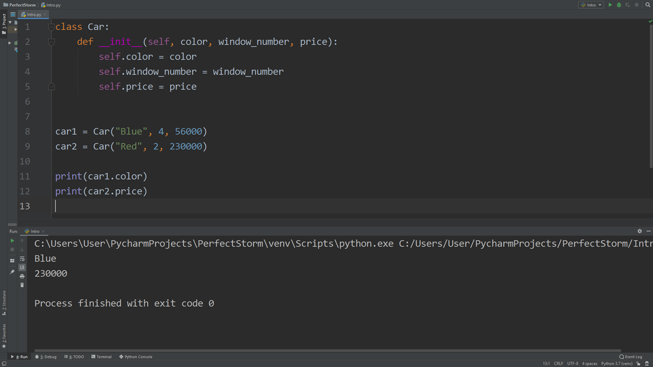
Object Creation
Object-Oriented Programming
Call the class by its name with a value corresponding to __init__
Use <object name>.<attribute> to access object attributes.
Notes:
Explain that the code in the example shows two different objects of the same class.
Point out the differences between them.
Note: When defining a class with __init__ and variables, the variables must get values when creating the object.
For example, if a learner creates an object called Car without defining its price, an error will occur.
Practice:
Create a class called Animal, with an __init__ function that initialize its name, color, age, and speech type (a dog barks).
Create a loop that asks the user the following:
- How many animals do we have?
- What are their names, colors, ages, and speech types?
- List the animals.
Extra:
Save the details to a file.
For this exercise, remember to tell learners to use what they learned so far about implementation, functions, loops, and proper code management.

Slide 37
Lab PY-05-L8
Object-Oriented Programming
Implement OOP by creating a class and various objects.
Car Creation
20–30 Min.
Create a Car class that includes the __init__ function.
Create two objects from the class.
Print a different attribute from each object.
Windows, Linux, and macOS
Python 3
PyCharm
Lab document

Slide 38
TDX Arena Homework
Object-Oriented Programming
Use TDX Arena to gain a better understanding of recursion within the context of Python.
Sign into the TDX Arena platform.
Navigate to the Practice Arena.
Navigate to the Python Programming course.
Select PY03 Looping & Math.
Select the Recursions lab.
Complete the homework before the next class.
Complete any labs or challenges you did not finish in class.
Recursions
Notes:
Learners will need to navigate to the appropriate TDX Arena practice arena as described in the slide.

Slide 39
Questions?
Thank You

